Slide 1

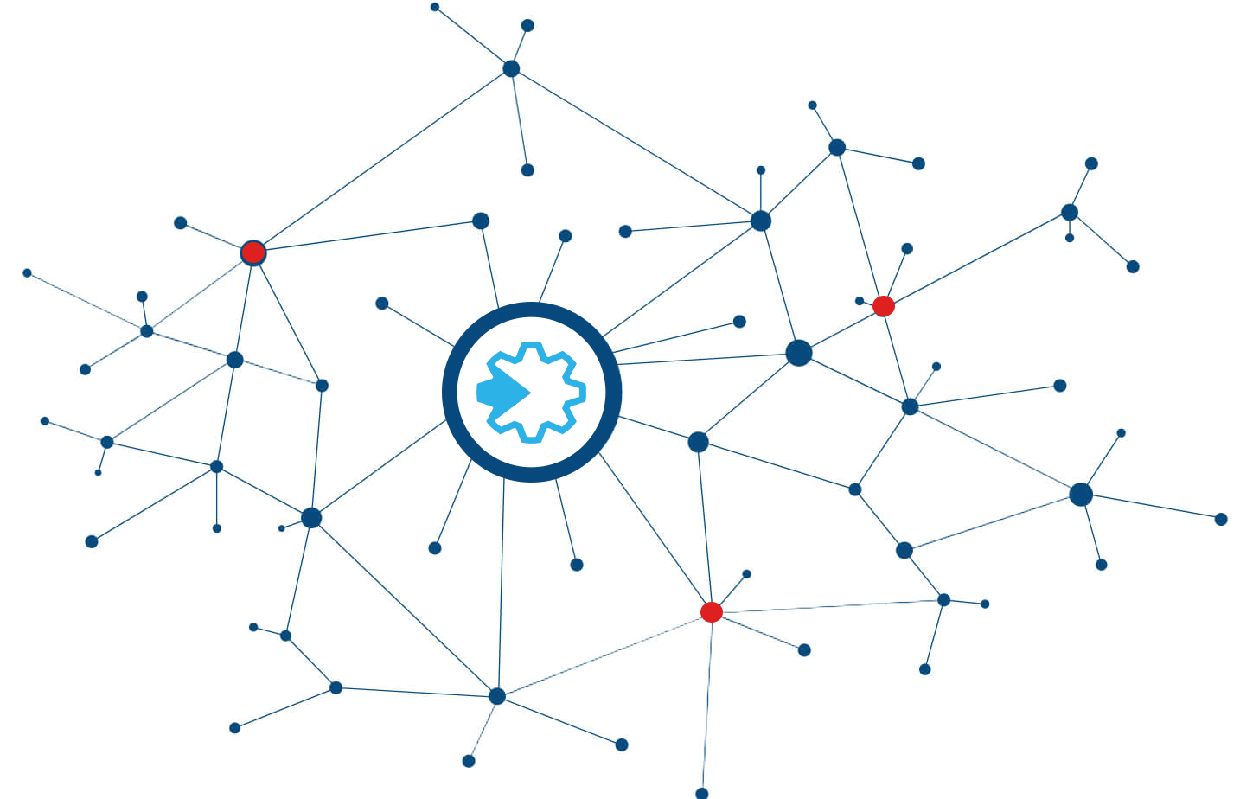
SUMMER INTERNSHIP PROGRAM 2022 (GYANODAY), ERLDC
Title: The Role of Blockchain Technology in Power Markets
Presented by
Group 7
Hansraj Kumar (IIEST, Shibpur)
Asha Kumari (NIT Sikkim)
Dishari Chandra (Jadavpur University)
Under mentorship of Sh. Ranadip Das, Mgr. (POSOCO)

Slide 2

CONTENTS
Overview of Blockchain Technology
Brief overview of various envisaged challenges in power-market in near-future.
How blockchain technologies can help to solve them.
Applications of these technologies in Indian context.
Lessons learnt and recommendations.

Slide 3
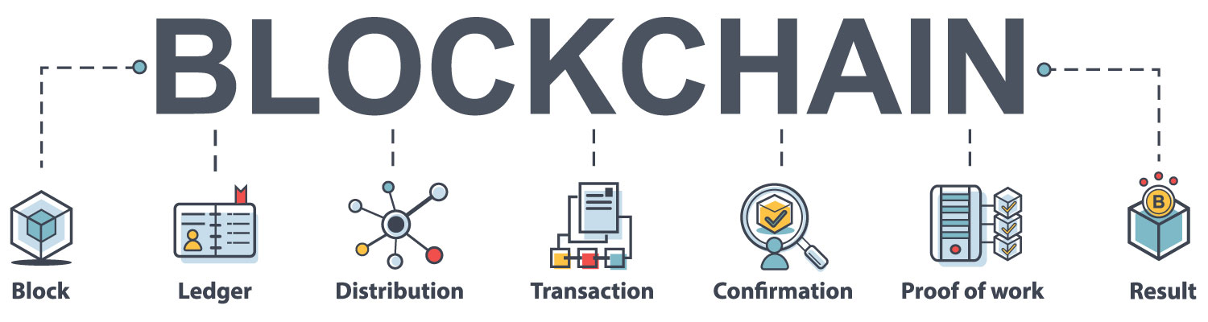
What is Blockchain technology?
Blockchain is a distributed and immutable ledger of transactions without the need for central governance and trusted third parties. It can assist multiple applications at the generation, transmission, distribution, and consumption stages in the power system to resolve existing challenges.
How does it work?
Transaction
A transaction is requested and authenticated.
Block
A block representing the transaction is created.
Verification
Approved and valid from everyone in the network.
Hash
The update is distributed across the network.
Execution
Transaction is completed.

Slide 4
Four-Layer Blockchain Stack :
Layer 1: Cryptographic Algorithms and Consensus Protocols Layer
Layer 2: Decentralized Operation Layer
Layer 3: Decentralized Computing Platforms Layer
Layer 4: Application Layer

Slide 5
Fundamental Principles:
The digital transaction in a blockchain are often guided by computational logic.
Computational Logic
P2P network divides the entire workload among the participants who get equal privileges.
Peer-to-Peer Network
This principle of a decentralized network is the driving ideology for cryptocurrencies.
Distributed Database
Consensus Protocol
A common protocol guides the validation of blocks every time the node adds them.
Immutable Ledger
Once a transaction is entered into database, it is impossible to change the records.

Slide 6
Blockchain Domain
Security
Access to reliable and affordable sources of energy
Scalability
ability of the platform to support increasing load of transactions, as well as increasing the number of nodes in the network
Decentralization
Makes customers active elements of the system, though requires significant coordination

Slide 7
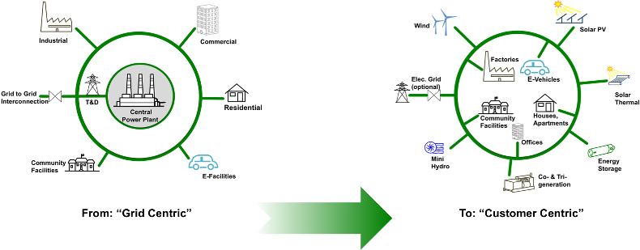
Energy System Evolution:
Centralized and De-centralized Grid

Slide 8
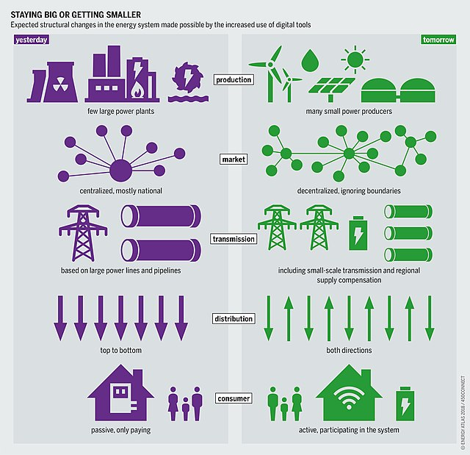
Centralized
vs
De-centralized
Subject | Centralized | De-centralized
Production | Few large power plants | Many small power producers
Market | Centralized, mostly national | Decentralized, ignoring boundaries
Transmission | Based on large lines and pipelines | Including small-scale and regional supply compensation
Distribution | Top to bottom | Both directions
Consumer | Passive, only paying | Active, participating in the system.

Slide 9
Summary of how Blockchain can address Market Challenges
Electricity market prices are lower than the actual total cost of production: Combined with IoT, stores and shares information about the time of generation/demand, location, type of generation/demand and other aspects to carefully craft price signals to market participants. Dynamic Pricing can be used.
Effects of large scale RES integration into the grid: Can be used for efficient, automated and decentralized grid management and control. Due to presence of large number of consuming/producing entities supply/demand balance can be improved.
Power resources adequacy and Centralized Marker Inaccessible to DER: Cryptocurrencies can be used to ‘tokenize’ assets to create innovative and new markets or business models based on co ownership and sharing of assets.
System stability risk due to supply demand imbalance: Efficient, automated and decentralized grid asset management and control, improved balancing of supply and demand between different network level and areas.
Lack of residential Demand Response: Enabling local energy and consumer-oriented marketplaces or microgrids with local storage and smart contracts. Network will be transparent and tracible by the consumers and prosumers.
Data Privacy: Secured and authenticated transactions of data through cryptography, protection against data manipulation.

Slide 10
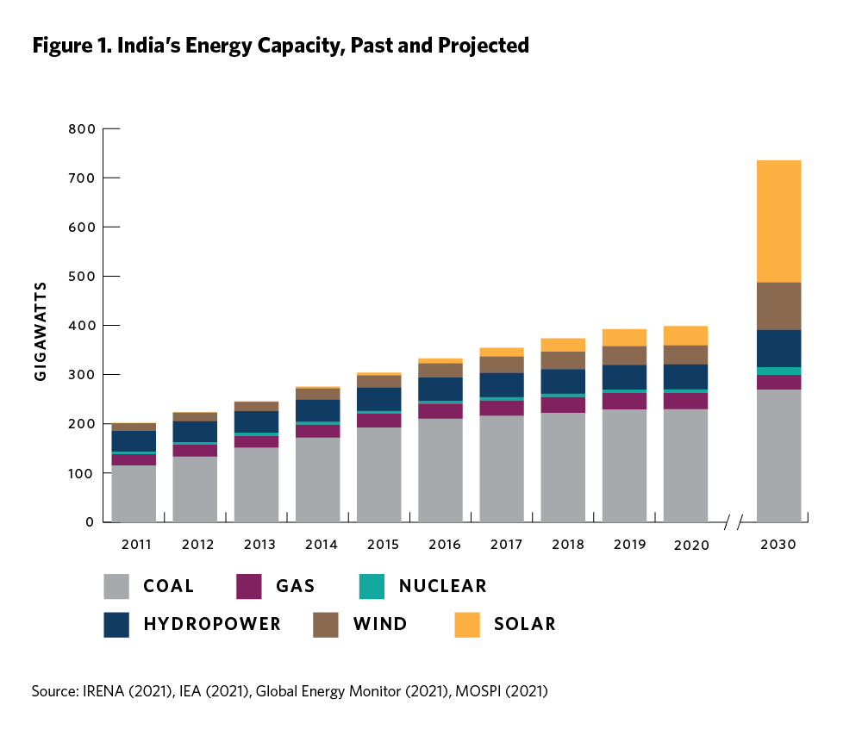
Transformation of Indian Grid:
The Indian Govt. has set a target of 175 GW of renewable energy capacity by 2022 which comprises of 40 GW of rooftop solar.
In 2015, India has pledged a 33-35% reduction in the “emissions intensity” of its economy by 2030,compared to 2005 levels.

Slide 11

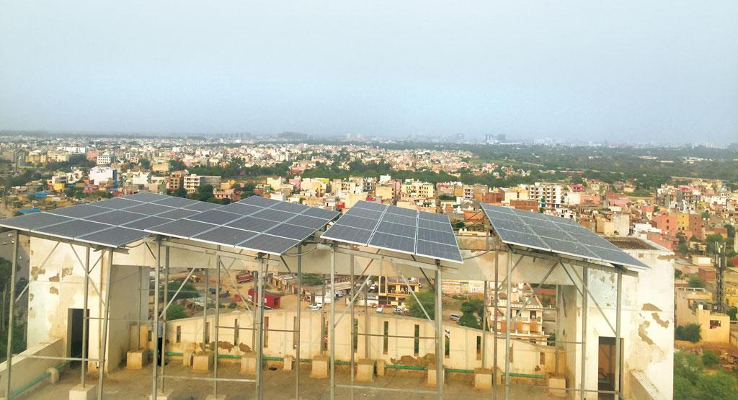
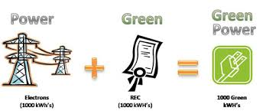
Application of Blockchain in Indian Power System:
Largely three areas where Blockchain Technology may be used in India.
Rooftop Solar: Solar Roof Top power system made consumers of electricity also producers of electricity. Blockchain technology may provide a mechanism to trade renewable energy through using Smart Contract, introducing Crypto Coin as Solar Coin based on output of solar energy produced. Smart Contract needs to be designed in such a way that prosumers will participate in renewable energy market with benefits.
Renewable Energy Certificate Mechanism: Renewable Energy Certificate seeks to address the mismatch between availability of RE sources and the requirement of the obligated entities to meet their renewable purchase obligation by purchasing green attributes of renewable remotely located in country. REC mechanism is a market based instrument to promote renewable energy and facilitate renewable purchased obligation.
Development of Mini Grid with Renewable Energy including Solar Pumps: Government of India notifies guidelines for implementation of PM KUSUM scheme. There are three components in this scheme:
Component-A: Setting up of 10,000 MW of decentralized Ground/Stilt Mounted Grid Connected Solar or other renewable energy based power plant.
Component-B: Installation of 17.50 lakh stand-alone Solar Agriculture Pumps.
Component-C: Solarization of 10 lakh grid connected Agriculture Pumps.

Slide 12
Other Probable Applications:
Peer-to-Peer Trading
EV Charging and Sharing
Decentralized Wholesale Trading
Smart Meters and Smart Contracts
Renewable Energy Production

Slide 13
CASE STUDIES and EXAMPLES:
Electricity Distributor BSES Rajdhani Power Limited (BRPL):
BRPL partnered with Power Ledger, a global leader in blockchain-based renewable energy trading, to install a large-scale P2P energy trading trial in Delhi, India. It is the first electricity distribution company (discom) in India to use P2P solar trading technology powered by Power Ledger. The trial initially comprised 5-6 MW of existing solar infrastructure, servicing a group of gated communities (CGHS) in the Dwarka region in Delhi.
During this trial, residents with rooftop solar infrastructure sold excess solar energy to their neighbors, rather than letting it spill back to the grid. This enabled the participants access to cheaper, renewable energy and prosumers to monetize their investment in solar assets. So, BRPL was able to access a cost-effective energy alternative during the times of peak demand pricing leading to increased efficiency and reliability of the power supply.
Uttar Pradesh Electricity Regulatory Commission (UPERC):
UPERC in their revised solar policy issued in December 2018, mooted the idea of peer-to-peer (P2P) trading of electricity from solar rooftop generation leveraging Blockchain technology. The secure and decentralized nature of blockchain technology is well suited to implement and automate smart contracts for peer-to-peer (P2P) transactions. The smart home appliances connected to an energy trading platform could continuously look for the cheapest and cleanest electricity offer and automatically connect to the new energy provider through smart contracts executed on blockchain. This experience will allow the customers to interact from their home or office directly to energy sellers.

Slide 14
CASE STUDIES and EXAMPLES:
GridExchange pilot project (Canada), August 2021
The GridExchange pilot project was launched by a Canadian utility, Alectra. Natural Resources Canada funded the project in partnership with Sunverge (a cloud-based software platform provider), Savage Data (an energy services provider), and FLO (an EV charging infrastructure provider). GridExchange is a blockchain technology-based software platform that enables distributed energy resources (DERs) such as solar PV, battery energy storage systems (BESS), and EVs to participate in an energy marketplace. Initially, 21 Ontario households participated in the three-month pilot programme . Under this programme, each clean energy transaction is recorded, and customers are compensated with cash and ‘GxRewards’ that can be redeemed at local shops and restaurants.
Renewable Energy Certificate (REC) marketplace (United States), January 2020
In partnership with a renewable energy registry, Midwest Renewable Energy Tracking System (M-RETS), and Clearway Energy Group (a renewable energy developer), Power Ledger3 launched a global REC marketplace to streamline the buying and selling of RECs. Power Ledger’s TraceX, a digital marketplace for the trading and settlement of environmental commodities, will help reduce the costs involved in buying and selling RECs within M-RETS and introduce transparency.

Slide 15
Drawbacks:
It is not yet possible to make one chain that achieves all three competitive objectives.
Lack of Skilled technical and operational work force in Blockchain domain.
Requires infrastructure in place that can enable high speed transactions.
Blockchain technology is still a growing segment in India.

Slide 16
Recommendations:
Move away from the proof-of work validation method
Use of Blockchain to spur energy-efficient transportation methods
Build more energy-efficient blockchains

Slide 17

Conclusion:
Blockchain is revolutionary technology. The technology will affect every industry in the world, including manufacturing, retail, transportation.
Companies like Google, Microsoft, Intel, Dole are all working to become early adopters of blockchain.
As it is decentralized and cryptographic technology no one can hack it, hence there are lots of areas private, governments and peer-to-peer sector can use it.

Slide 18
References:
Links:
https://en.wikipedia.org/wiki/Blockchain
https://timesofindia.indiatimes.com/readersblog/raghib-blogs/opportunities-and-the-future-of-blockchain-technology-43325/
https://cfo.economictimes.indiatimes.com/news/understanding-the-legality-of-cryptocurrency-in-india/70429373
https://www.smart-energy.com/policy-regulation/bringing-blockchain-to-indias-power-consumers/
https://mercomindia.com/tata-power-blockchain-solar-trading-delhi/
https://www.energetica-india.net/articles/blockchain-technology-in-the-indian-power-sector
https://mnre.gov.in/
PDFs:
The role of blockchain in power-markets CIGRE
Blockchain-in-India_Gaganjot-Kaur-
7C_2_RE_India19_055_paper_Bhagat_Sanjay

Slide 19
Thank You

